Slide 1
6.2 Exercises: Histograms, Box Plots, and Bullet Charts
College: Bellevue University
Course: DSC640-T302 Data Presentation and Visualization
Instructor: Professor Williams
Report by: Jake Meyer
Date: 2/25/2023

Slide 2
Agenda
Power BI
1 histogram, 1 box plot, 1 bullet chart, and 1 additional chart of personal choice
Python Charts
1 histogram, 1 box plot, 1 bullet chart, and 1 additional chart of personal choice
R Charts
1 histogram, 1 box plot, 1 bullet chart, and 1 additional chart of personal choice
Appendix
Assignment instructions.
Data reference link.
Supporting code for each section.

Slide 3
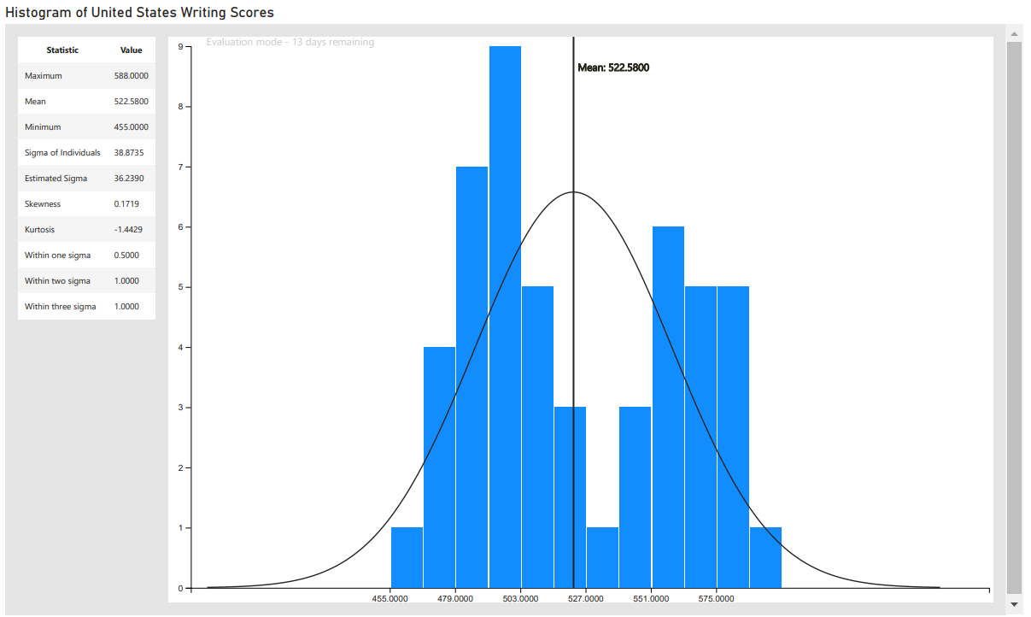
Power BI – Histogram
Histogram created in Power BI.
Histogram shows U.S. writing scores distribution (excludes District of Columbia).

Slide 4
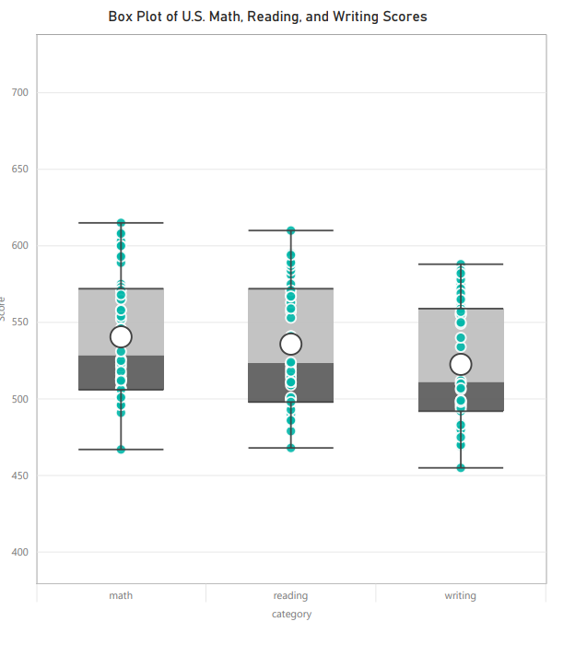
Power BI – Box Plot
Box Plot created in Power BI.
Plot shows distribution of U.S. scores by math, reading, and writing.

Slide 5
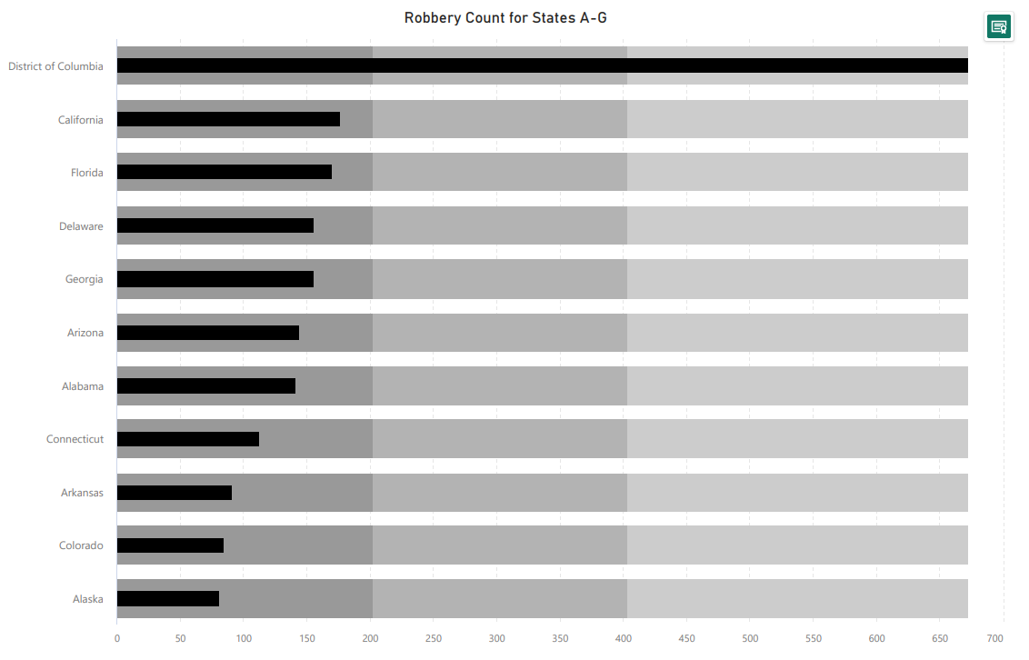
Power BI – Bullet Chart
Bullet chart created in Power BI.
Chart shows robbery count for U.S. States starting with letters A-G.

Slide 6
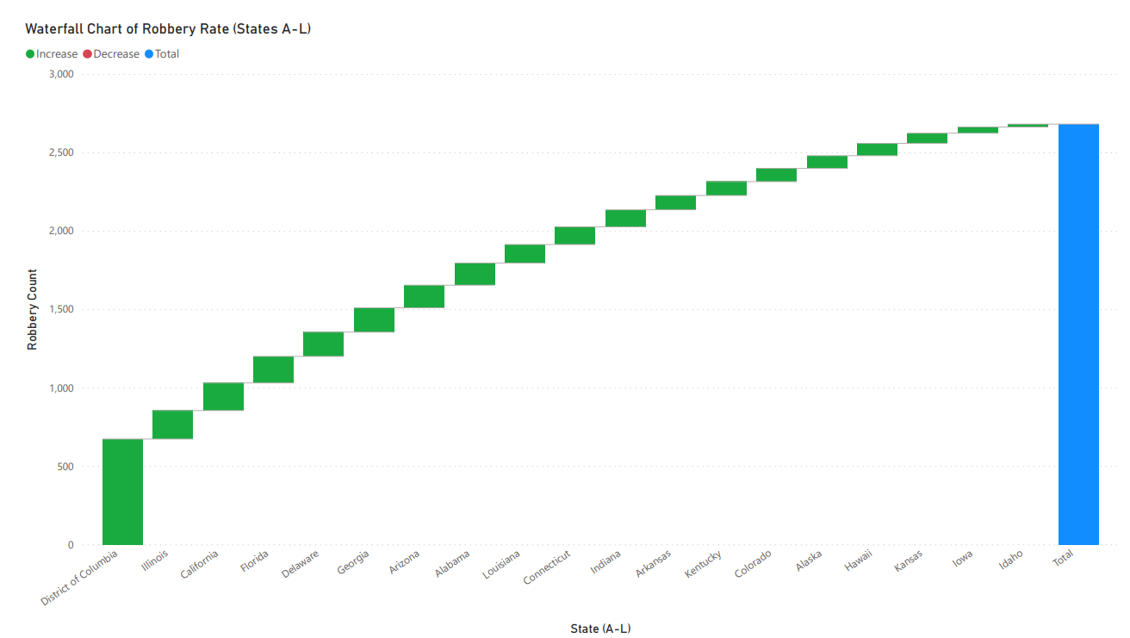
Power BI – Additional Chart
Chart created in Power BI.
Chart shows robbery count by states starting with letters A-L.

Slide 7
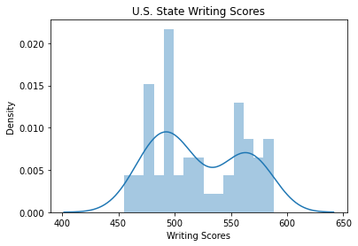
Python – Histogram
Histogram created in Python using Seaborn.
Histogram shows U.S. State writing scores.

Slide 8
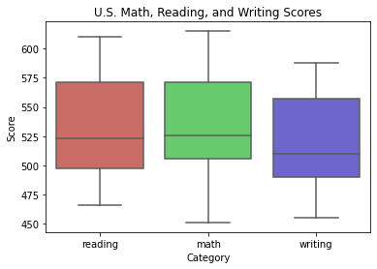
Python – Box Plot
Box Plot created in Python using Seaborn.
Plot shows reading, math, and writing scores within the U.S.

Slide 9
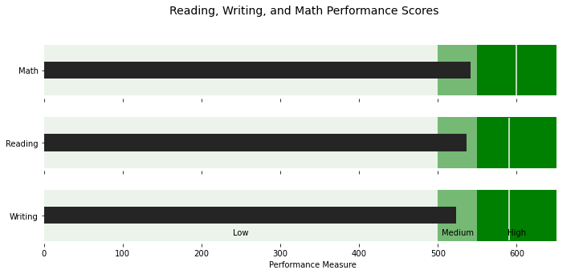
Python – Bullet Chart
Bullet chart created in Python.
Chart shows math, reading, and writing performance scores for U.S.

Slide 10
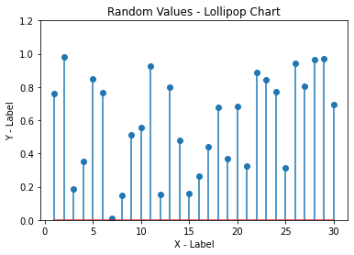
Python – Lollipop Chart
Chart created in Python with Matplotlib.
Chart shows 30 randomly selected values.

Slide 11
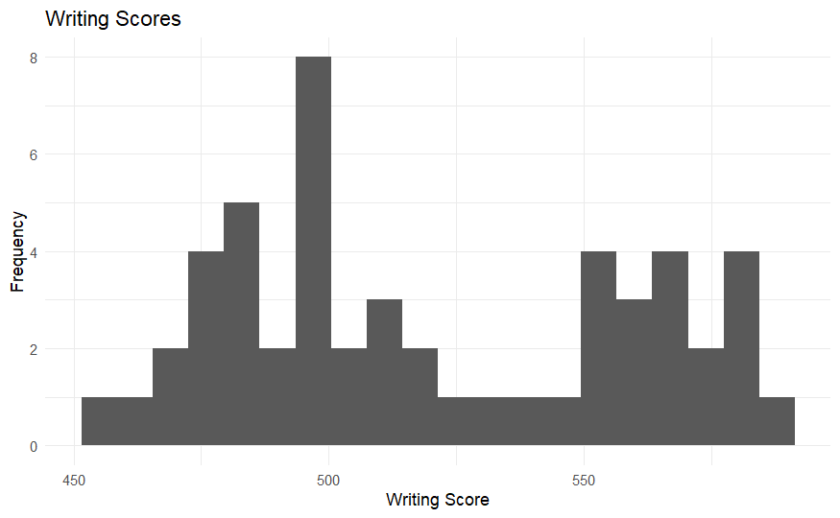
R – Histogram
Histogram created in R.
Histogram shows U.S. writing scores across the states.

Slide 12
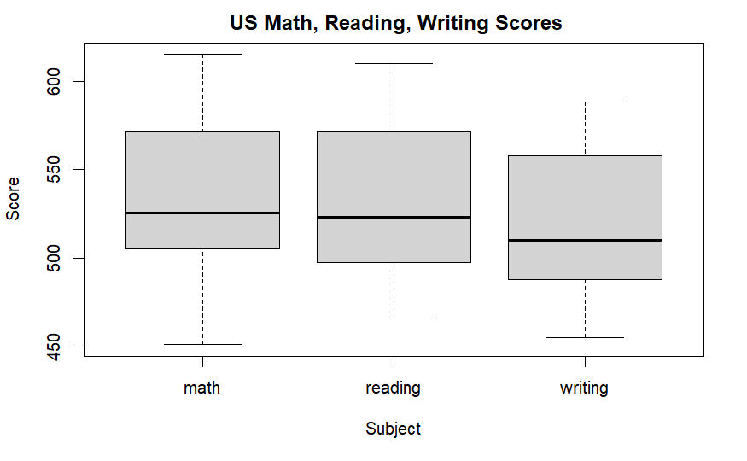
R – Box Plot
Box Plot created in R.
Plot shows U.S. math, reading, and writing scores.

Slide 13
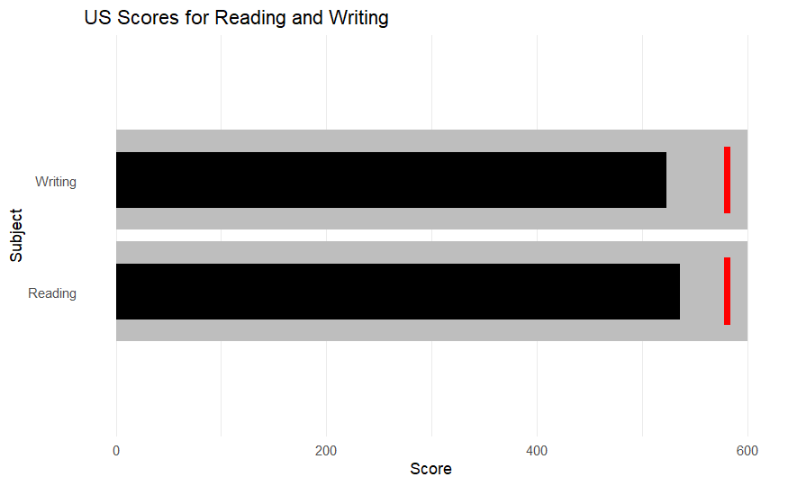
R – Bullet Chart
Bullet chart created in R.
Chart shows the US Scores for reading and writing.

Slide 14
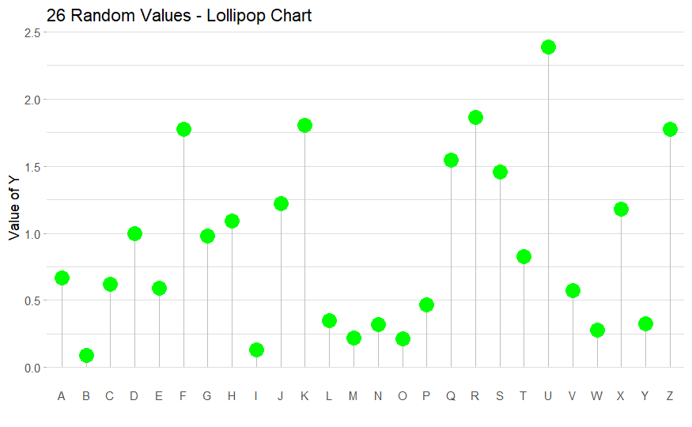
R – Additional Chart
Chart created in R.
Chart shows random Y values for the 26 letters of the alphabet.

Slide 15
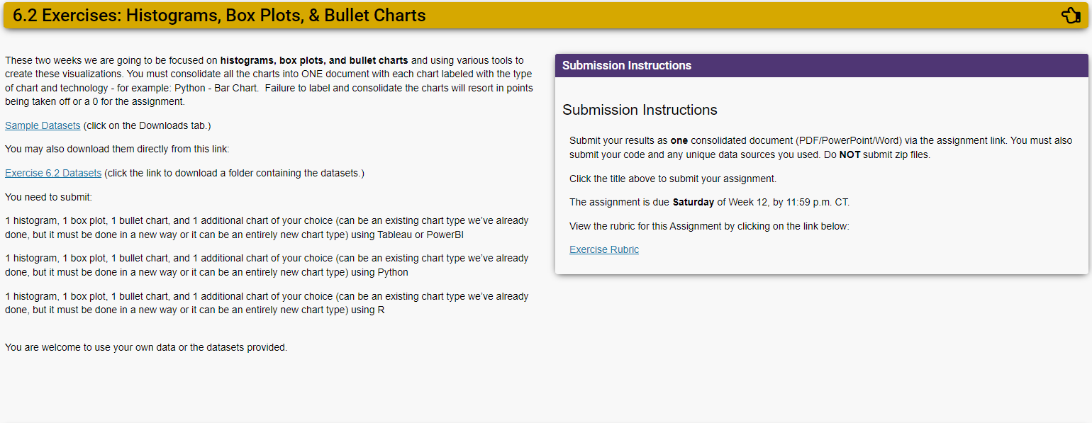
Assignment Instructions (DSC 640)

Slide 16
Dataset Reference(DSC 640)
https://content.bellevue.edu/cst/dsc/640/datasets/ex6-2.zip

Slide 17
Supporting Code Python
Python code summary in document below:

Slide 18
Supporting Code R
R Markdown code summary in document below:

